Slide 1
Predicting House Prices In Ames Iowa
Shafik Al Sharif

Slide 2



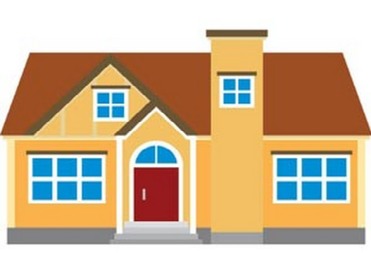
Problem Statement

Slide 3
Assumptions
There are many features that can affect the house prices
Taking all these features into account is time consuming
I will use Ames Iowa data set to identify the top features that affect house prices

Slide 4
Data Set
The data set came directly from Ames City Assessor’s Office and was compiled by a statistics professor named Dean Decock
Contains 79 explanatory variables describing almost every home aspect in Ames ,Iowa

Slide 5

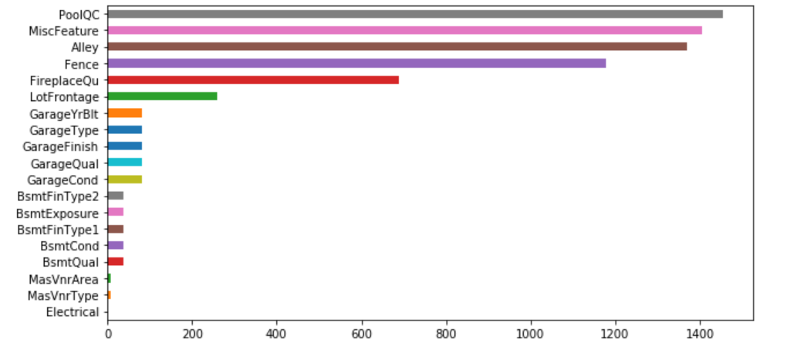
Missing Values

Slide 6
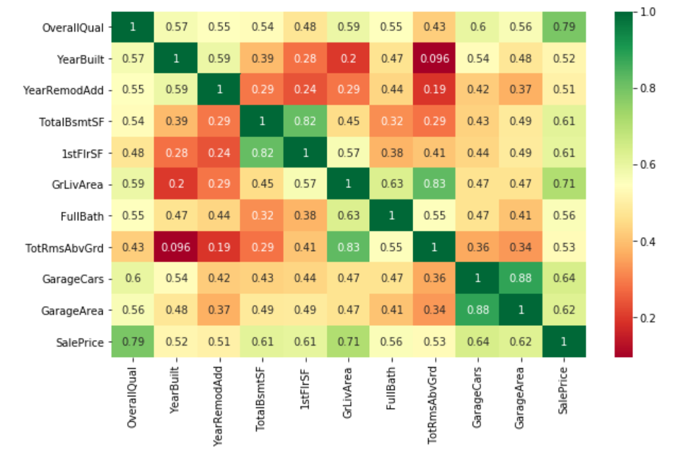

Slide 7
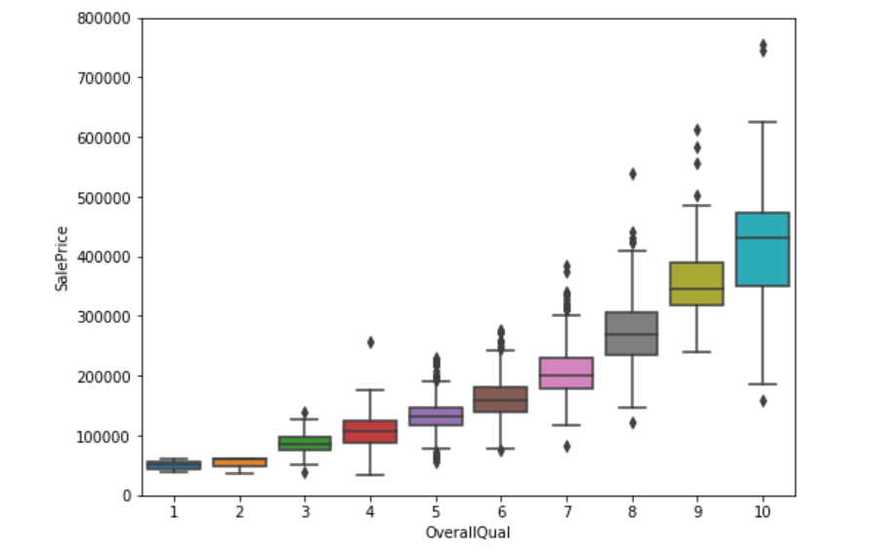

Slide 8
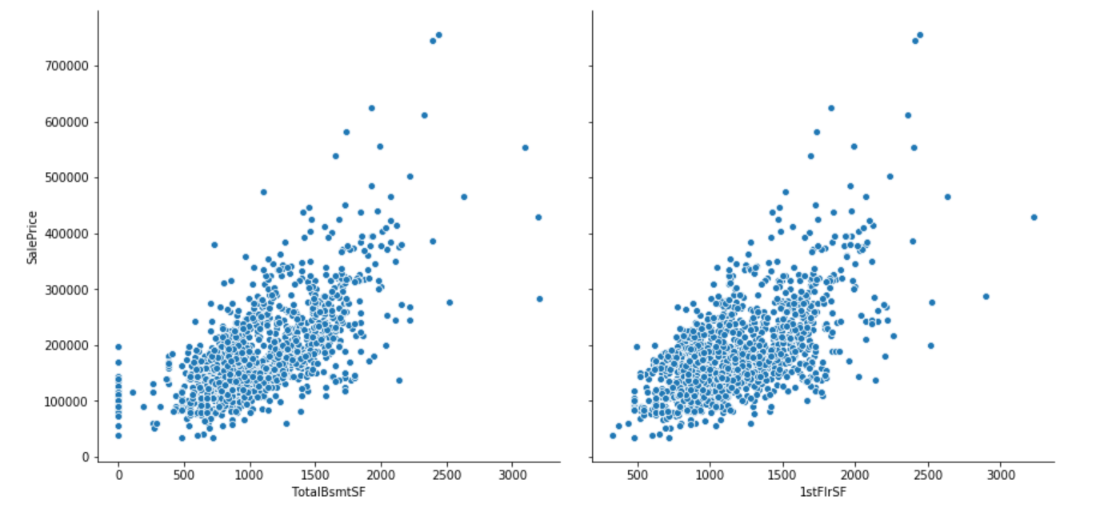
Multicollinearity

Slide 9
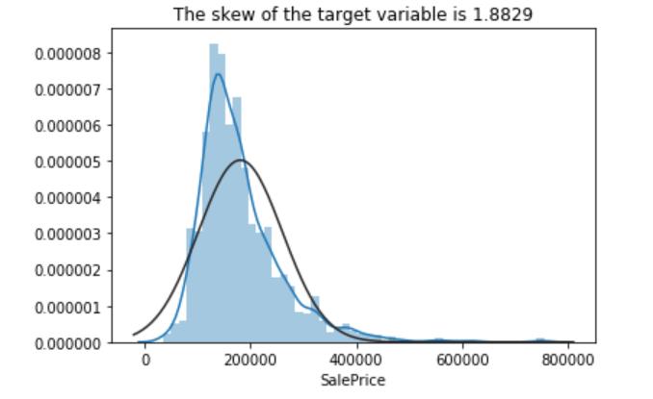
Price Distribution

Slide 10
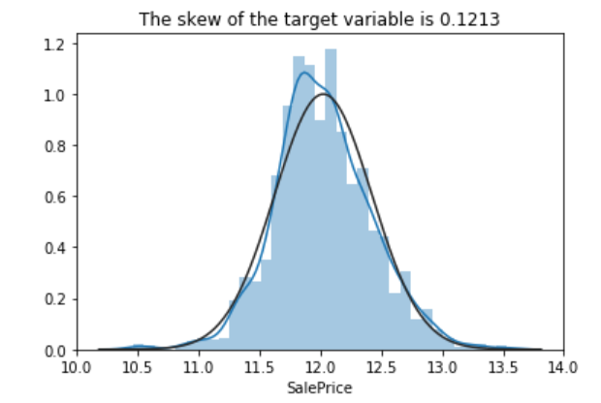
Price Transformation

Slide 11
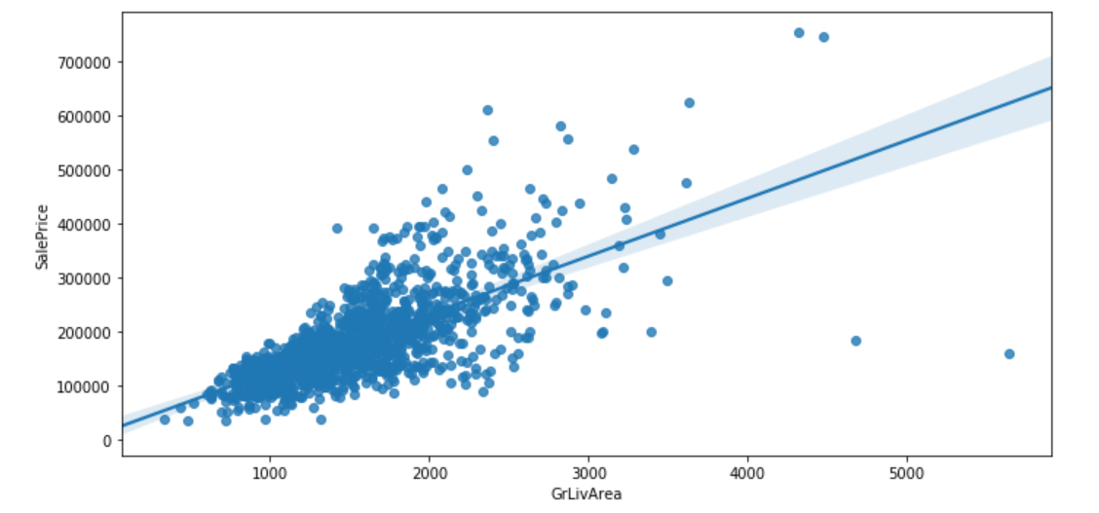
Outliers

Slide 12
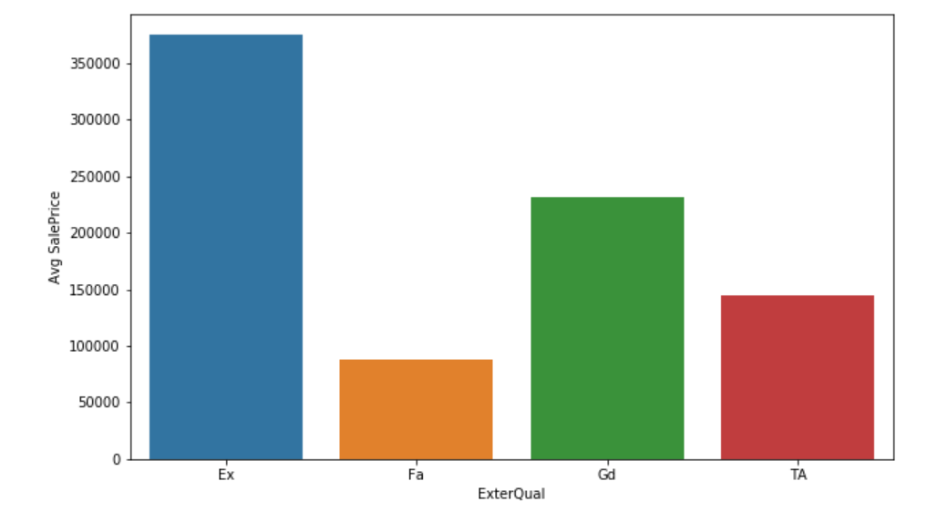
Categorical Ordinal features

Slide 13
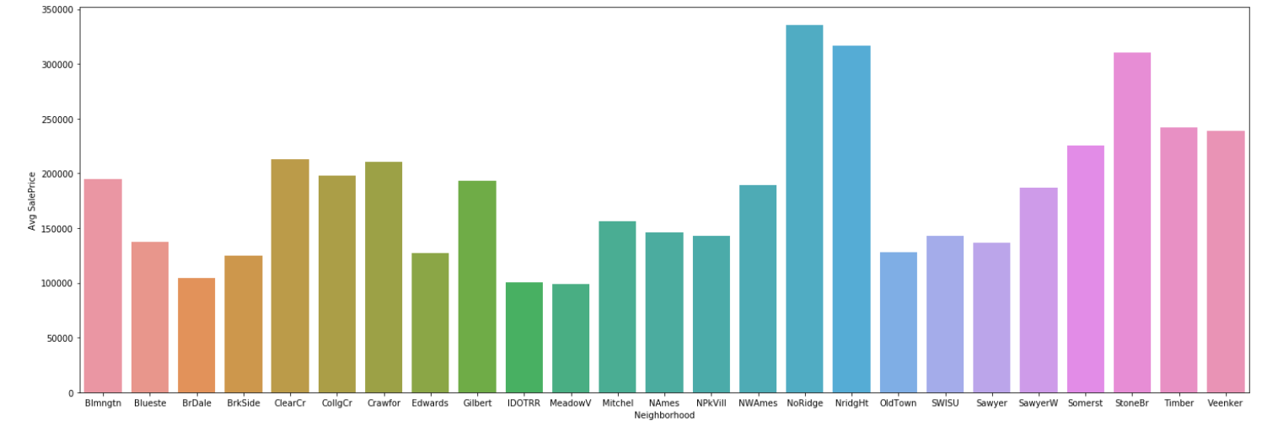
Categorical Nominal features

Slide 14
Summary:
'OverallQual' has the highest correlation with price followed by 'GrLivArea' and 'TotalBsmtSF'
'TotalBsmtSF' and '1stFlrSF' are two sides of the same coin hence only 'TotalBsmtSF' will be considered
'GarageCars' and 'GarageArea' are also two sides of the same coin hence only 'GarageCars' will be considered
Missing values are in columns that subjectively does not seem important plus does not have high correlation with price. Hence such columns will be ignored
Most important numerical features: ['OverallQual', 'GrLivArea', 'GarageCars', 'TotalBsmtSF', 'FullBath','YearBuilt','YearRemodAdd']
Most important categorical features:['Neighborhood'],['ExterQual'] which are already converted to numerical dummies

Slide 15
Validation
Model | RMSE | RMSE Real prices | R2_score
Linear Regression | 0.136 | 25230 | 0.886
Decision Tree | 0.192 | 34563 | 0.777
Random Forest | 0.146 | 31546 | 0.871

Slide 16
Recommendation
By collecting the right data for our market, we can create the right model to estimate the house prices and judge weather the price given by a real estate broker is fair or not

Slide 17


